Slide 1
Topic Modeling
Peitian Zhang
Renmin University of China
Currently @ MSRA Social Computing
Notes:
Hi everyone. I’m Peitian Zhang from Renmin University of China. Today I’m going to present several papers about topic modeling and share my insights.

Slide 2
Outline
Overview
Datasets
Metrics
Traditional Methods
Neural Methods
PLM-based Methods
Notes:
I will first give an overview of topic modeling, then I will introduce common datasets, metrics in this field. After that I will present 3 types of works from non-neural to PLM based.

Slide 3
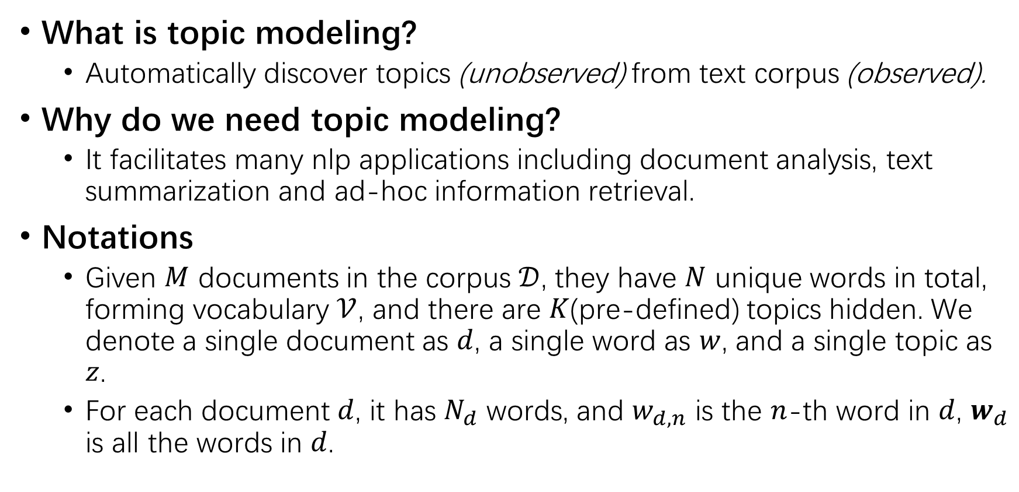
Overview
What is topic modeling?
Automatically discover topics (unobserved) from text corpus (observed).
Why do we need topic modeling?
It facilitates many nlp applications including document analysis, text summarization and ad-hoc information retrieval.
Notations
Given $M$ documents in the corpus $𝒟$, they have $N$ unique words in total, forming vocabulary $𝒱$, and there are $K$(pre-defined) topics hidden. We denote a single document as $d$, a single word as $w$, and a single topic as $z$.
For each document $d$, it has $N_{d}$ words, and $w_{d,n}$ is the $n$-th word in $d$, $w_{d}$ is all the words in $d$.
Notes:
What is topic modeling? It is a set of unsupervised methods that auto

Slide 4
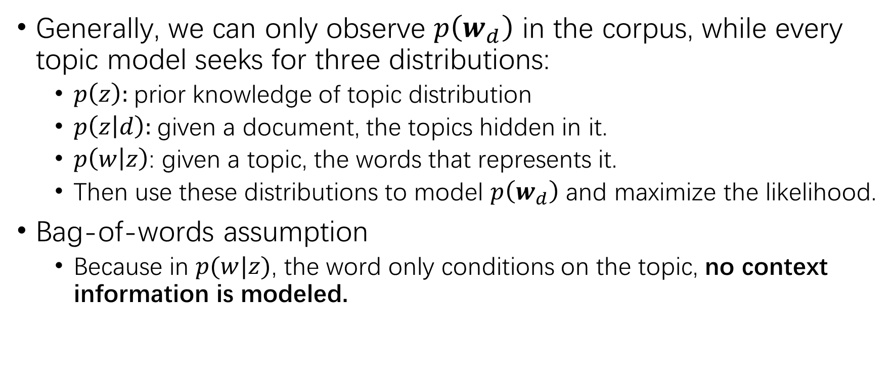
Overview
Generally, we can only observe $p\left(w_{d}\right)$ in the corpus, while every topic model seeks for three distributions:
$p\left(z\right)$: prior knowledge of topic distribution
$p\left(z | d\right)$: given a document, the topics hidden in it.
$p\left(w | z\right)$: given a topic, the words that represents it.
Then use these distributions to model $p\left(w_{d}\right)$ and maximize the likelihood.
Bag-of-words assumption
Because in $p(w|z)$, the word only conditions on the topic, no context information is modeled.

Slide 5
Datasets
20Newsgroups
A collection of approximately 20,000 annotated articles, partitioned evenly across 20 different topics.
NYTimes
A collection of 180000 news articles published between 1987 and 2007.
Different papers use different preprocessing methods to filter out some documents or words, resulting in different document/word number in total.

Slide 6
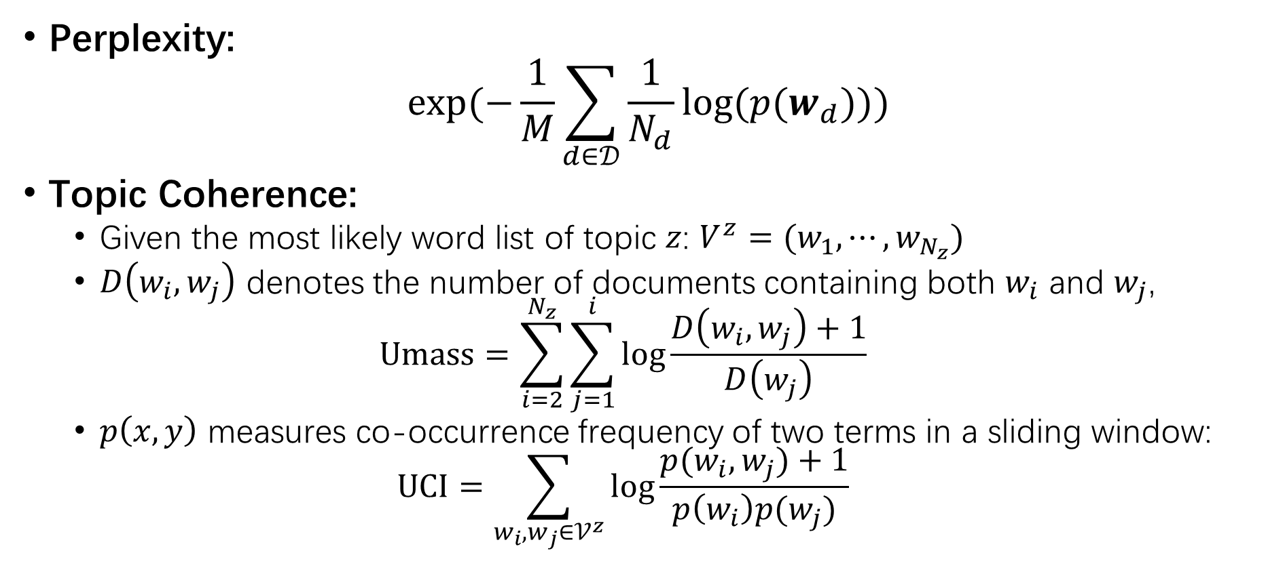
Metrics
Perplexity:
$$exp⁡(−\frac{1}{M}\sum_{d∈𝒟}{\frac{1}{N_{d}}log⁡(p(w_{d}))})$$
Topic Coherence:
Given the most likely word list of topic $z$: $V^{z}=(w_{1},⋯,w_{N_{z}})$
$D\left(w_{i},w_{j}\right)$ denotes the number of documents containing both $w_{i}$ and $w_{j}$,
$$Umass=\sum_{i=2}^{N_{z}}{\sum_{j=1}^{i}{\log{\frac{D\left(w_{i}, w_{j}\right)+1}{D\left(w_{j}\right)}}}}$$
$p\left(x,y\right)$ measures co-occurrence frequency of two terms in a sliding window:
$$UCI=\sum_{w_{i},w_{j}∈𝒱^{z}}{\log{\frac{p(w_{i},w_{j})+1}{p\left(w_{i}\right)p(w_{j})}}}$$

Slide 7
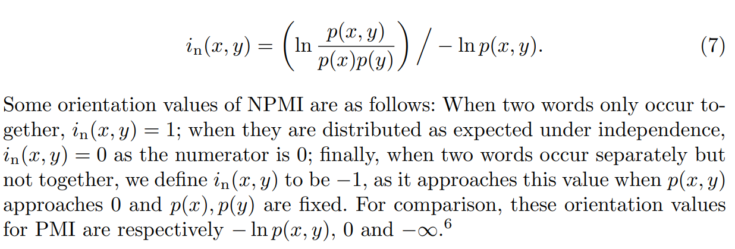
Metrics
Topic Coherence
Normalized Pointwise Mutual Information (Normalized UCI)

Slide 8
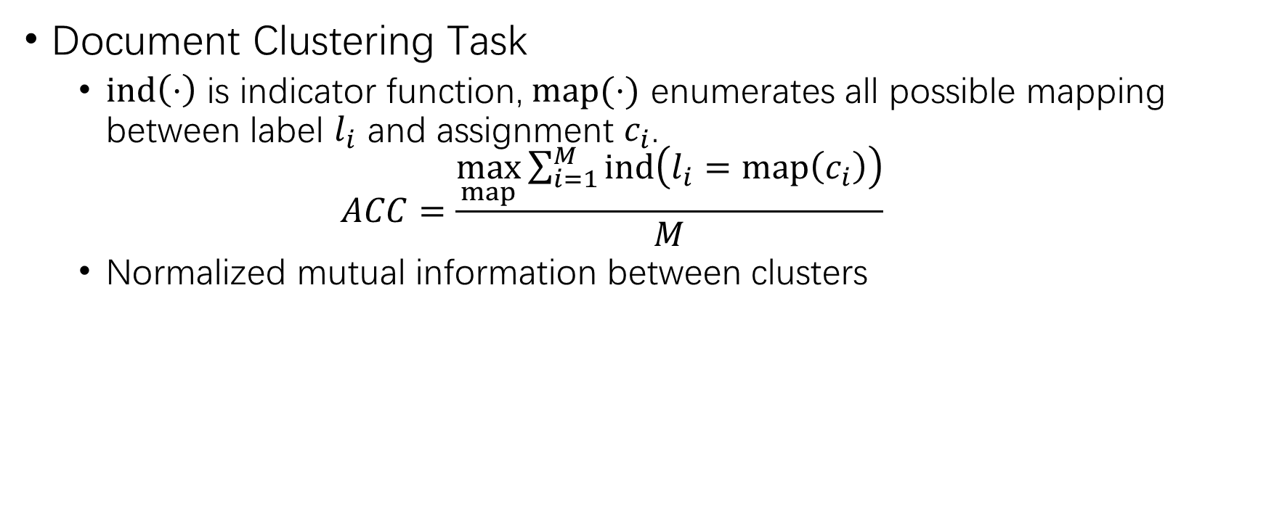
Metrics
Document Clustering Task
$ind\left(⋅\right)$ is indicator function, $map(⋅)$ enumerates all possible mapping between label $l_{i}$ and assignment $c_{i}$.
$$ACC=\frac{\max_{map}{\sum_{i=1}^{M}{ind\left(l_{i}=map\left(c_{i}\right)\right)}}}{M}$$
Normalized mutual information between clusters

Slide 9
Traditional Methods
Resort to analytic solutions;
Difficult math;

Slide 10
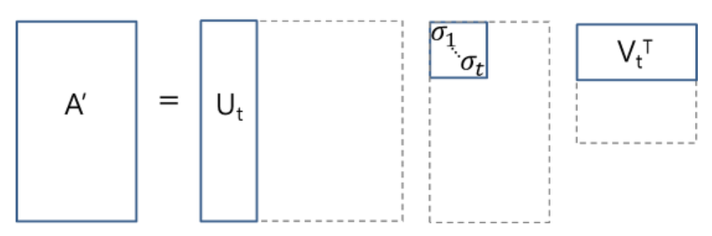
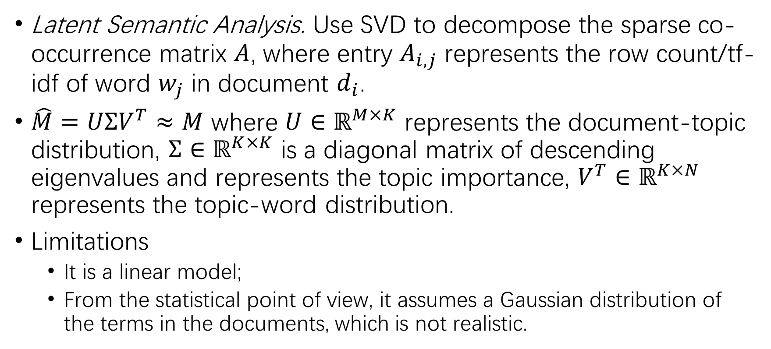
LSA
Latent Semantic Analysis. Use SVD to decompose the sparse co-occurrence matrix $A$, where entry $A_{i,j}$ represents the row count/tf-idf of word $w_{j}$ in document $d_{i}$.
$\hat{M}=UΣV^{T}≈M$ where $U∈ℝ^{M×K}$ represents the document-topic distribution, $Σ∈ℝ^{K×K}$ is a diagonal matrix of descending eigenvalues and represents the topic importance, $V^{T}∈ℝ^{K×N}$ represents the topic-word distribution.
Limitations
It is a linear model;
From the statistical point of view, it assumes a Gaussian distribution of the terms in the documents, which is not realistic.

Slide 11
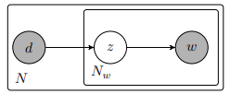
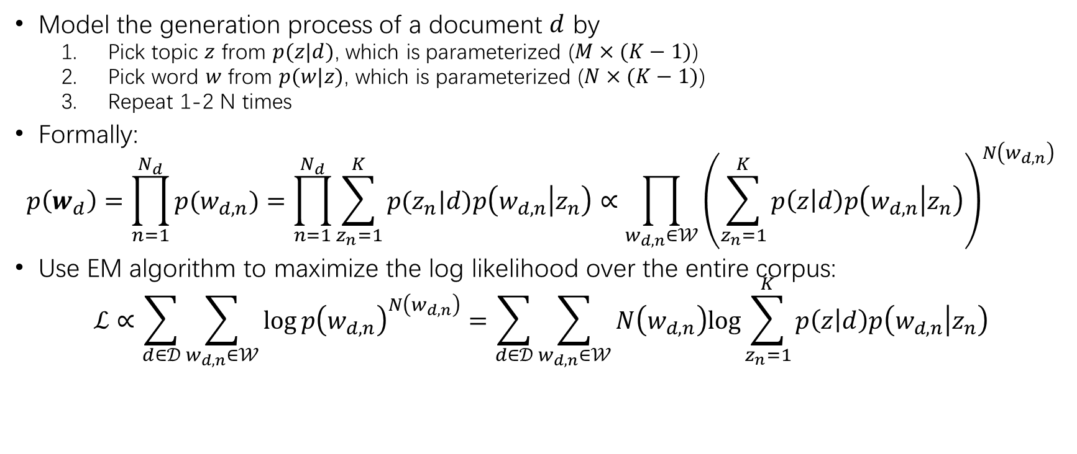
PLSA
Model the generation process of a document $d$ by
Pick topic $z$ from $p(z|d)$, which is parameterized ($M×(K−1)$)
Pick word $w$ from $p(w|z)$, which is parameterized ($N×(K−1)$)
Repeat 1-2 N times
Formally:
$$p\left(w_{d}\right)=\prod_{n=1}^{N_{d}}{p(w_{d,n})}=\prod_{n=1}^{N_{d}}{\sum_{z_{n}=1}^{K}{p(z_{n}|d)p\left(w_{d,n} | z_{n}\right)}}∝\prod_{w_{d,n}∈𝒲}{{\left(\sum_{z_{n}=1}^{K}{p\left(z | d\right)p\left(w_{d,n} | z_{n}\right)}\right)}^{N\left(w_{d,n}\right)}}$$
Use EM algorithm to maximize the log likelihood over the entire corpus:
$$ℒ∝\sum_{d∈𝒟}{\sum_{w_{d,n}∈𝒲}{\log{p{\left(w_{d,n}\right)}^{N\left(w_{d,n}\right)}}=\sum_{d∈𝒟}{\sum_{w_{d,n}∈𝒲}{N\left(w_{d,n}\right)log{\sum_{z_{n}=1}^{K}{p\left(z | d\right)p\left(w_{d,n} | z_{n}\right)}}}}}}$$

Slide 12
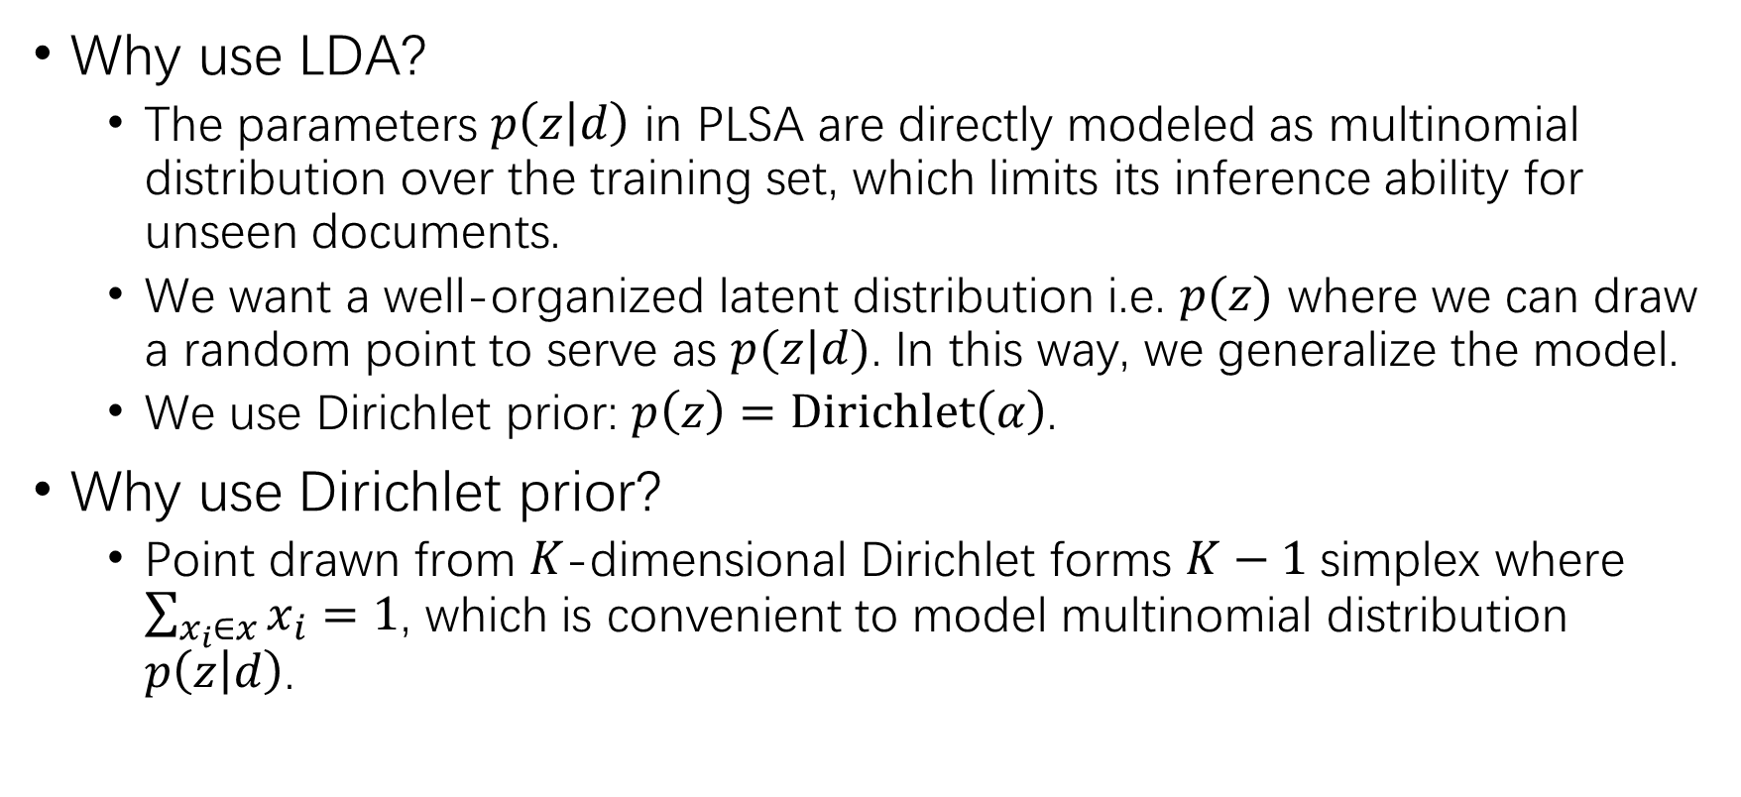
LDA
Why use LDA?
The parameters $p\left(z | d\right)$ in PLSA are directly modeled as multinomial distribution over the training set, which limits its inference ability for unseen documents.
We want a well-organized latent distribution i.e. $p(z)$ where we can draw a random point to serve as $p(z|d)$. In this way, we generalize the model.
We use Dirichlet prior: $p\left(z\right)=Dirichlet\left(α\right)$.
Why use Dirichlet prior?
Point drawn from $K$-dimensional Dirichlet forms $K−1$ simplex where $\sum_{x_{i}∈x}{x_{i}}=1$, which is convenient to model multinomial distribution $p\left(z | d\right)$.

Slide 13
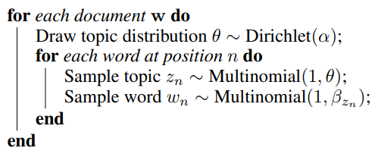
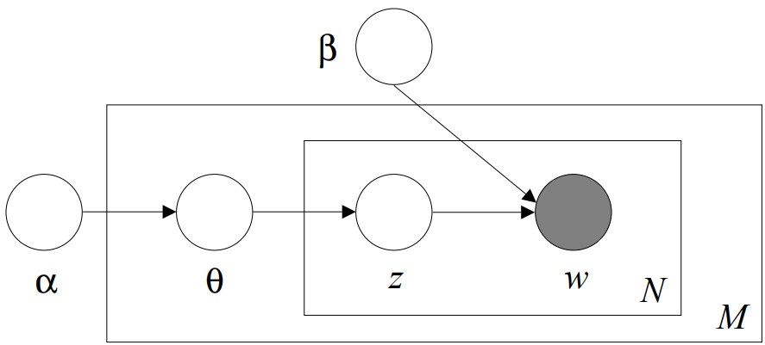
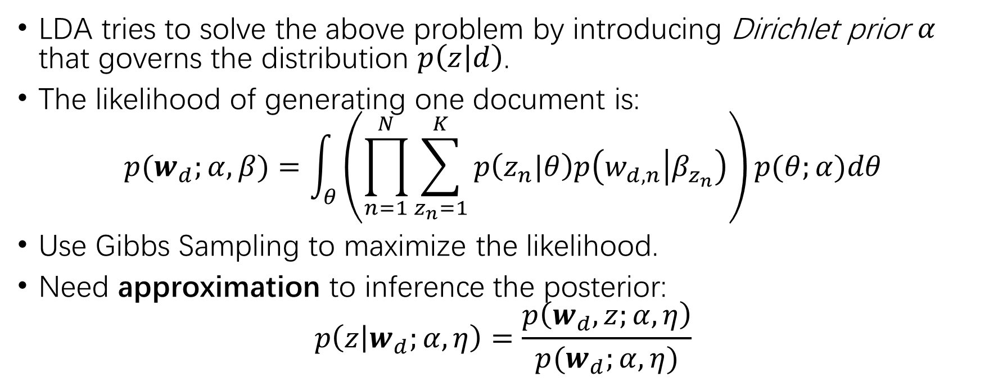
LDA
LDA tries to solve the above problem by introducing Dirichlet prior $α$ that governs the distribution $p\left(z | d\right)$.
The likelihood of generating one document is:
$$p(w_{d};α,β)=\int_{θ}{\left(\prod_{n=1}^{N}{\sum_{z_{n}=1}^{K}{p\left(z_{n}|θ\right)p\left(w_{d,n} | β_{z_{n}}\right)}}\right)p(θ;α)dθ}$$
Use Gibbs Sampling to maximize the likelihood.
Need approximation to inference the posterior:
$$p\left(z | w_{d};α,η\right)=\frac{p\left(w_{d},z;α,η\right)}{p(w_{d};α,η)}$$

Slide 14
Neural Methods
Aims:
Solve the intractable posterior of LDA
Combine word relatedness(embedding) to Topic Modeling
Methods
Use neural networks as black box to inference posterior
Variational Inference
GAN encoder
Involve word embedding in forming the latent topic distribution

Slide 15
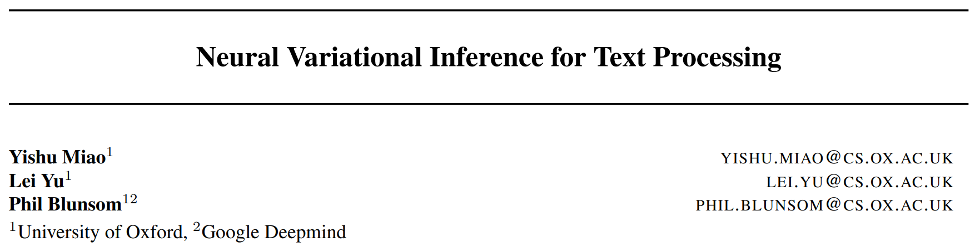
Variational Inference
ICML 2016

Slide 16
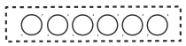
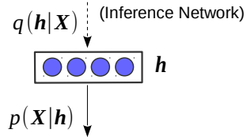

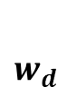
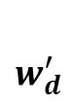
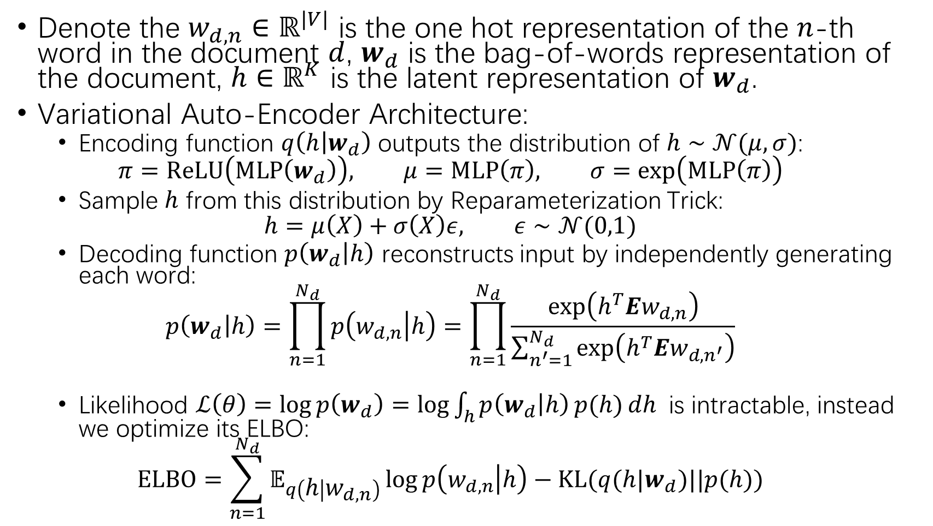
Denote the $w_{d,n}∈ℝ^{|V|}$ is the one hot representation of the $n$-th word in the document $d$, $w_{d}$ is the bag-of-words representation of the document, $h∈ℝ^{K}$ is the latent representation of $w_{d}$.
Variational Auto-Encoder Architecture:
Encoding function $q\left(h | w_{d}\right)$ outputs the distribution of $h∼𝒩(μ,σ)$:
$$π=ReLU\left(MLP\left(w_{d}\right)\right), μ=MLP\left(π\right), σ=\exp\left(MLP\left(π\right)\right)$$
Sample $h$ from this distribution by Reparameterization Trick:
$$h=μ\left(X\right)+σ\left(X\right)ε, ε∼𝒩(0,1)$$
Decoding function $p\left(w_{d} | h\right)$ reconstructs input by independently generating each word:
$$p\left(w_{d} | h\right)=\prod_{n=1}^{N_{d}}{p\left(w_{d,n} | h\right)}=\prod_{n=1}^{N_{d}}{\frac{\exp\left(h^{T}Ew_{d,n}\right)}{\sum_{n^{′}=1}^{N_{d}}{\exp\left(h^{T}Ew_{d,n^{′}}\right)}}}$$
Likelihood $ℒ\left(θ\right)=\log{p\left(w_{d}\right)=\log{\int_{h}{p\left(w_{d} | h\right)}p(h)}}dh$ is intractable, instead we optimize its ELBO:
$$ELBO=\sum_{n=1}^{N_{d}}{𝔼_{q\left(h | w_{d,n}\right)}\log{p\left(w_{d,n} | h\right)}}−KL(q(h|w_{d})||p(h))$$
$w_{d}$
$w_{d}^{′}$

Slide 17
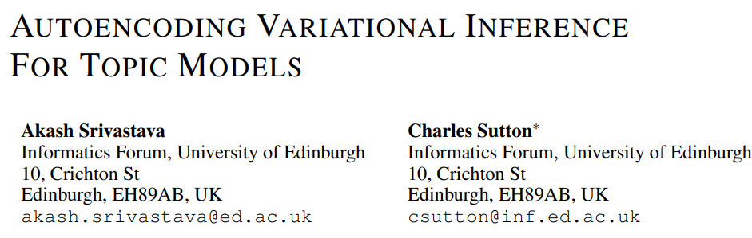
ICLR 2017

Slide 18
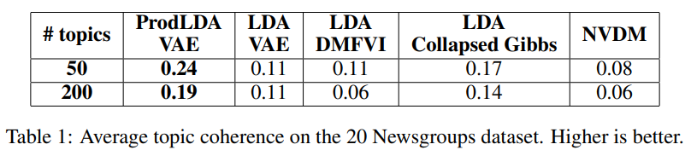
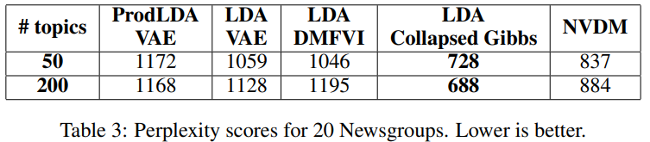
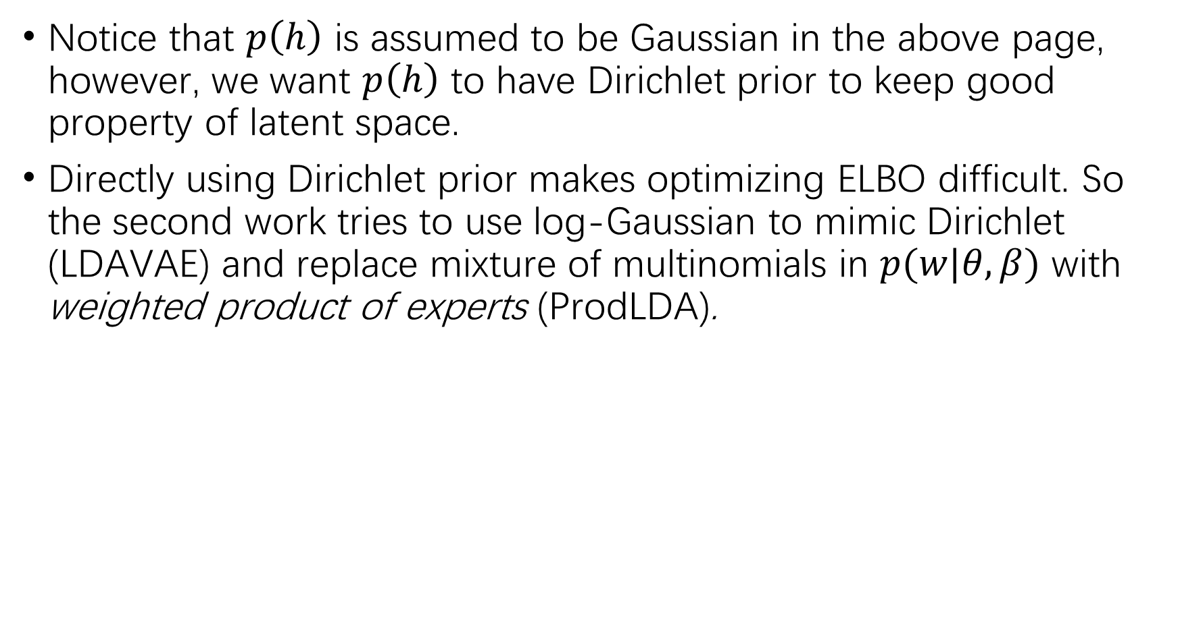
Notice that $p\left(h\right)$ is assumed to be Gaussian in the above page, however, we want $p\left(h\right)$ to have Dirichlet prior to keep good property of latent space.
Directly using Dirichlet prior makes optimizing ELBO difficult. So the second work tries to use log-Gaussian to mimic Dirichlet (LDAVAE) and replace mixture of multinomials in $p(w|θ,β)$ with weighted product of experts (ProdLDA).

Slide 19
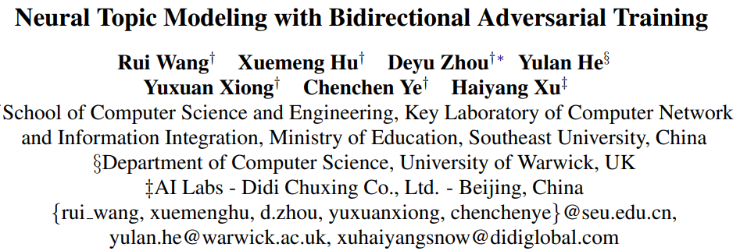
GAN
ACL 2020

Slide 20
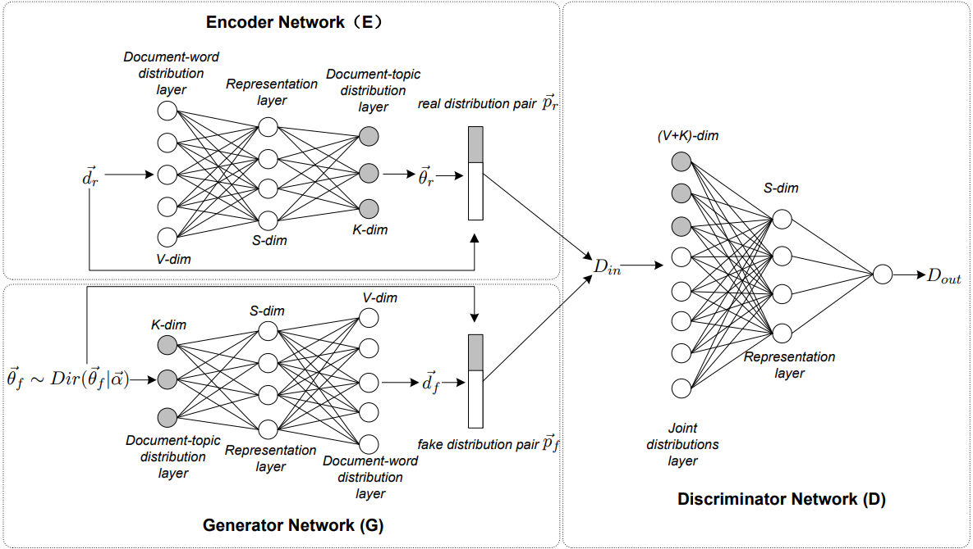
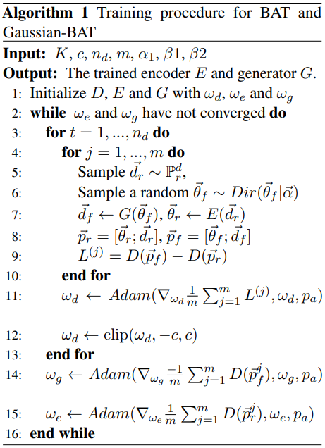
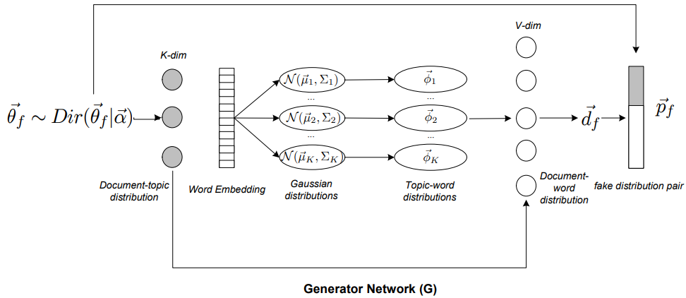
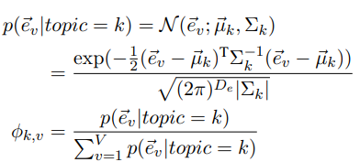
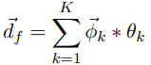

Slide 21
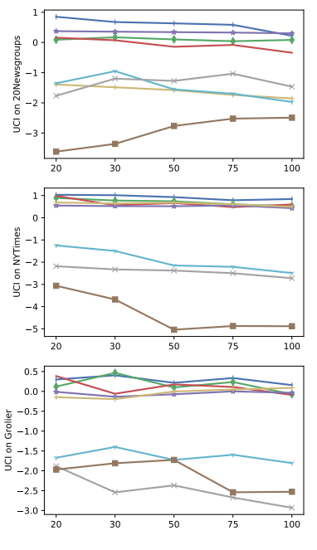
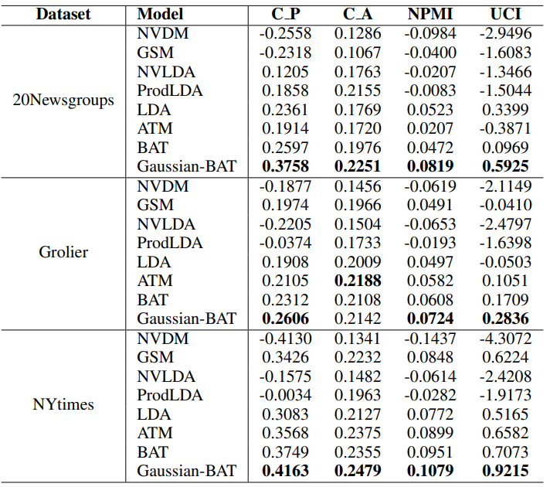

Slide 22

Combine word embedding
ACL 2020

Slide 23
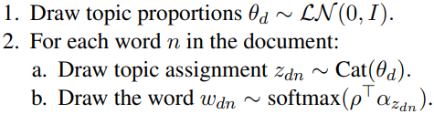
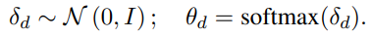
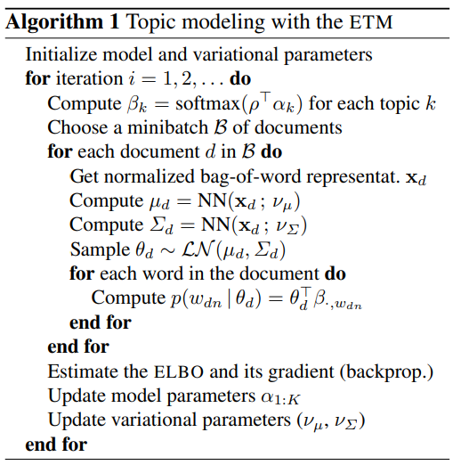
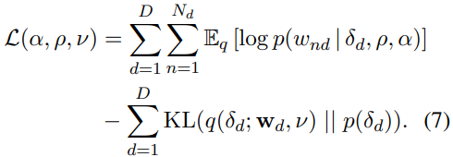
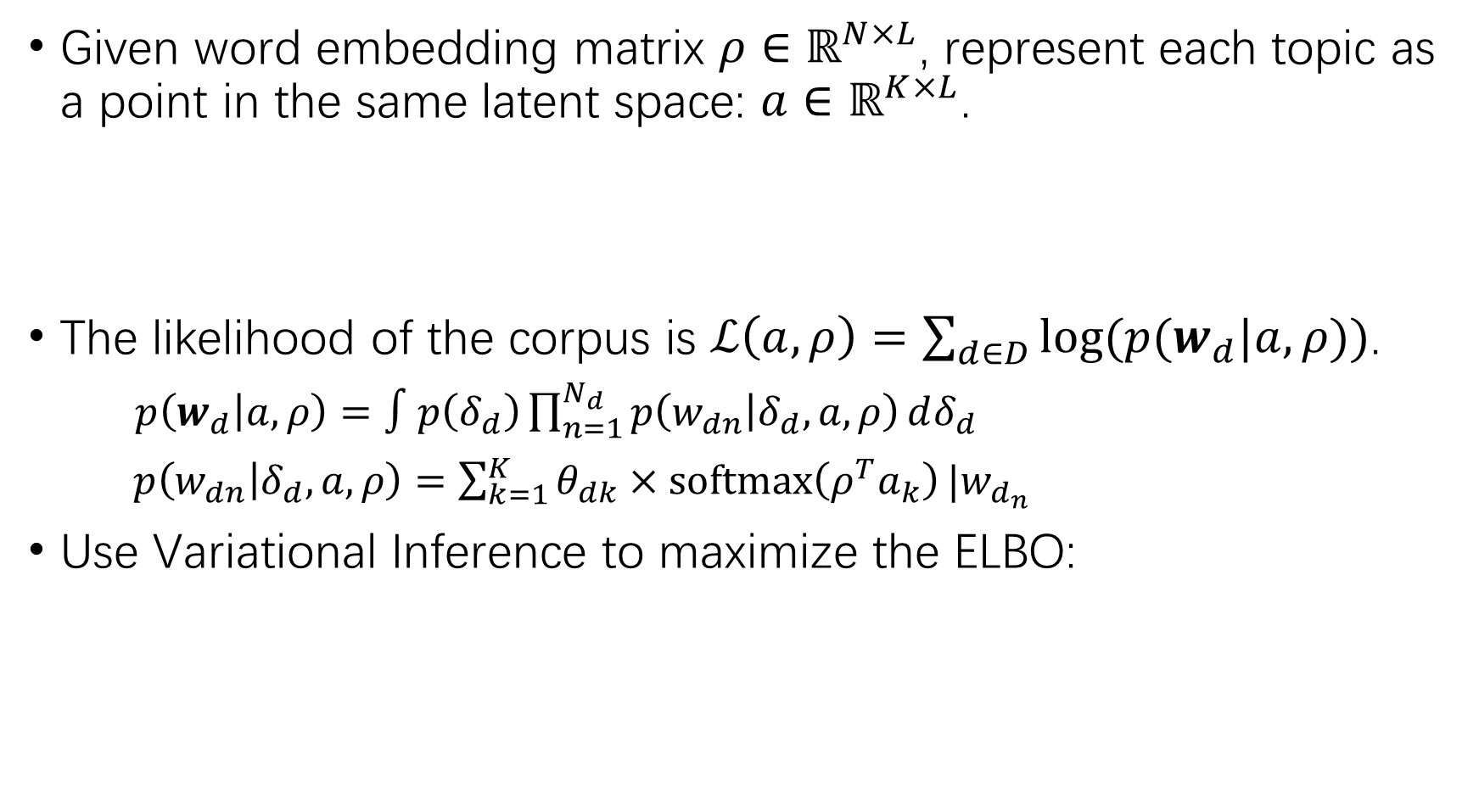
Given word embedding matrix $ρ∈ℝ^{N×L}$, represent each topic as a point in the same latent space: $a∈ℝ^{K×L}$.
The likelihood of the corpus is $ℒ\left(a,ρ\right)=\sum_{d∈D}{log⁡(p(w_{d}|a,ρ))}$.
$p\left(w_{d} | a,ρ\right)=∫p\left(δ_{d}\right)\prod_{n=1}^{N_{d}}{p\left(w_{dn} | δ_{d},a,ρ\right)}dδ_{d}$
$p\left(w_{dn} | δ_{d},a,ρ\right)=\sum_{k=1}^{K}{θ_{dk}×softmax\left(ρ^{T}a_{k}\right)}|w_{d_{n}}$
Use Variational Inference to maximize the ELBO:

Slide 24
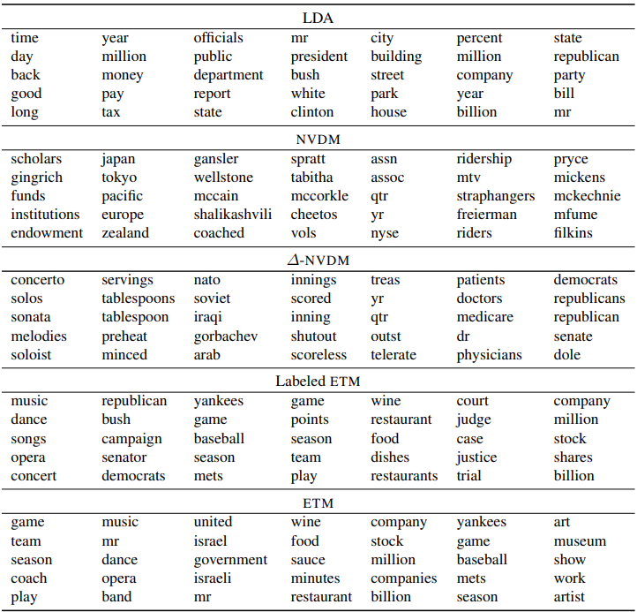

Slide 25
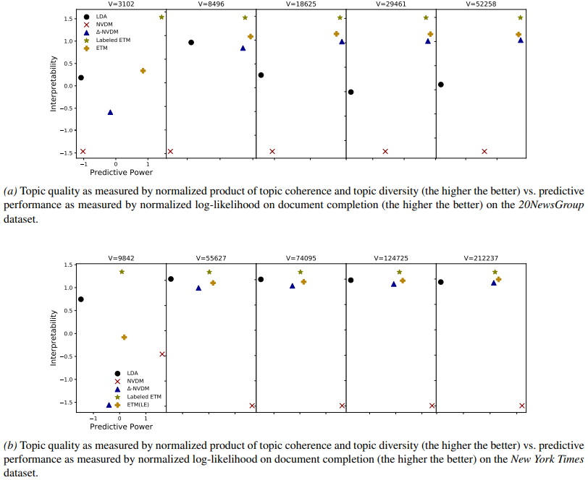
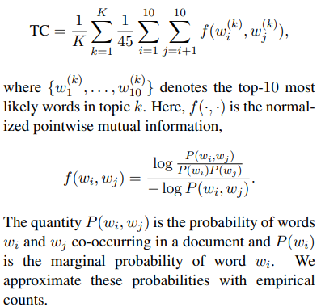
Topic Coherence
Document Completion Task
Divide each test document into two sets of words;
The first half is fed to the encoder for a topic proportion;
Use this topic proportion to generate the second set of words and compute likelihood.

Slide 26
BERT-based methods
Enjoy the merits of pretrained language models
Use contextualized embeddings to overcome bag-of-words.

Slide 27
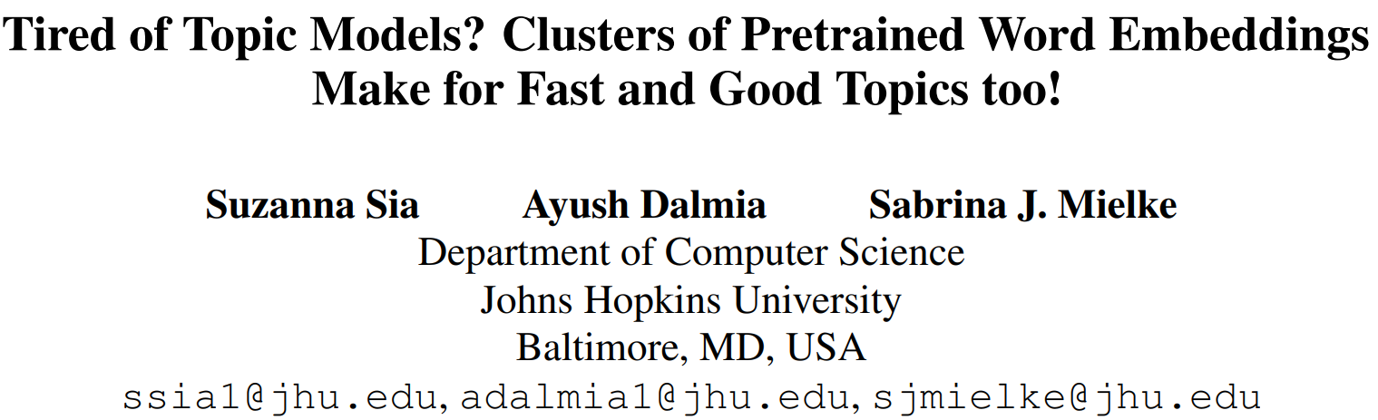

Slide 28
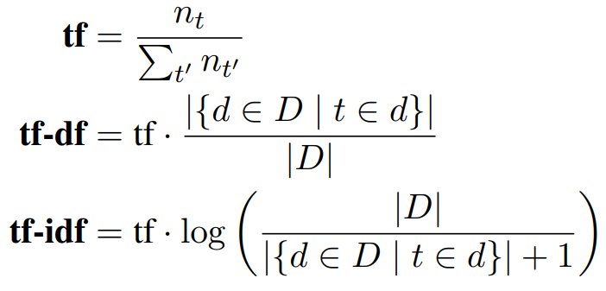
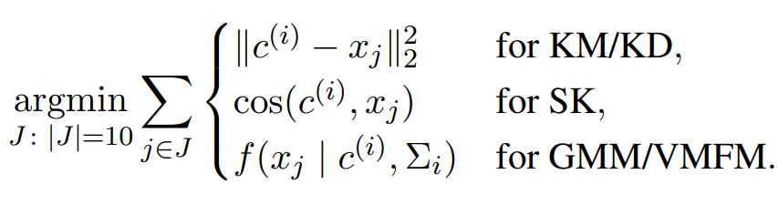
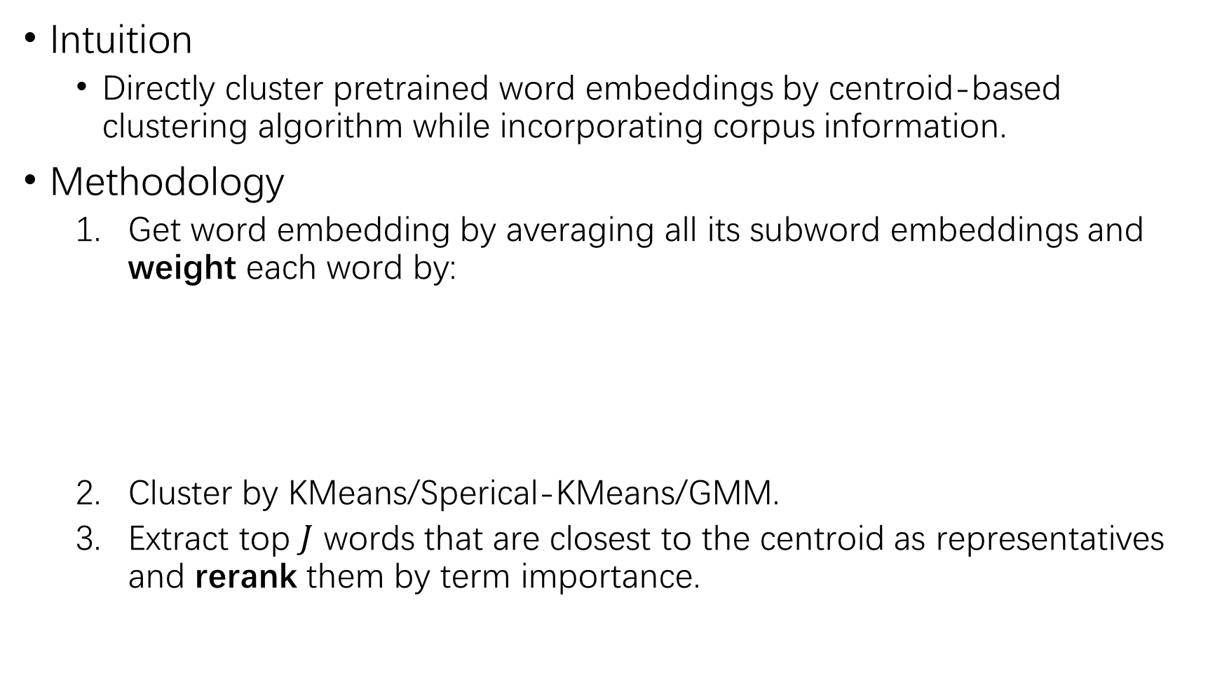
Intuition
Directly cluster pretrained word embeddings by centroid-based clustering algorithm while incorporating corpus information.
Methodology
Get word embedding by averaging all its subword embeddings and weight each word by:
Cluster by KMeans/Sperical-KMeans/GMM.
Extract top $J$ words that are closest to the centroid as representatives and rerank them by term importance.

Slide 29
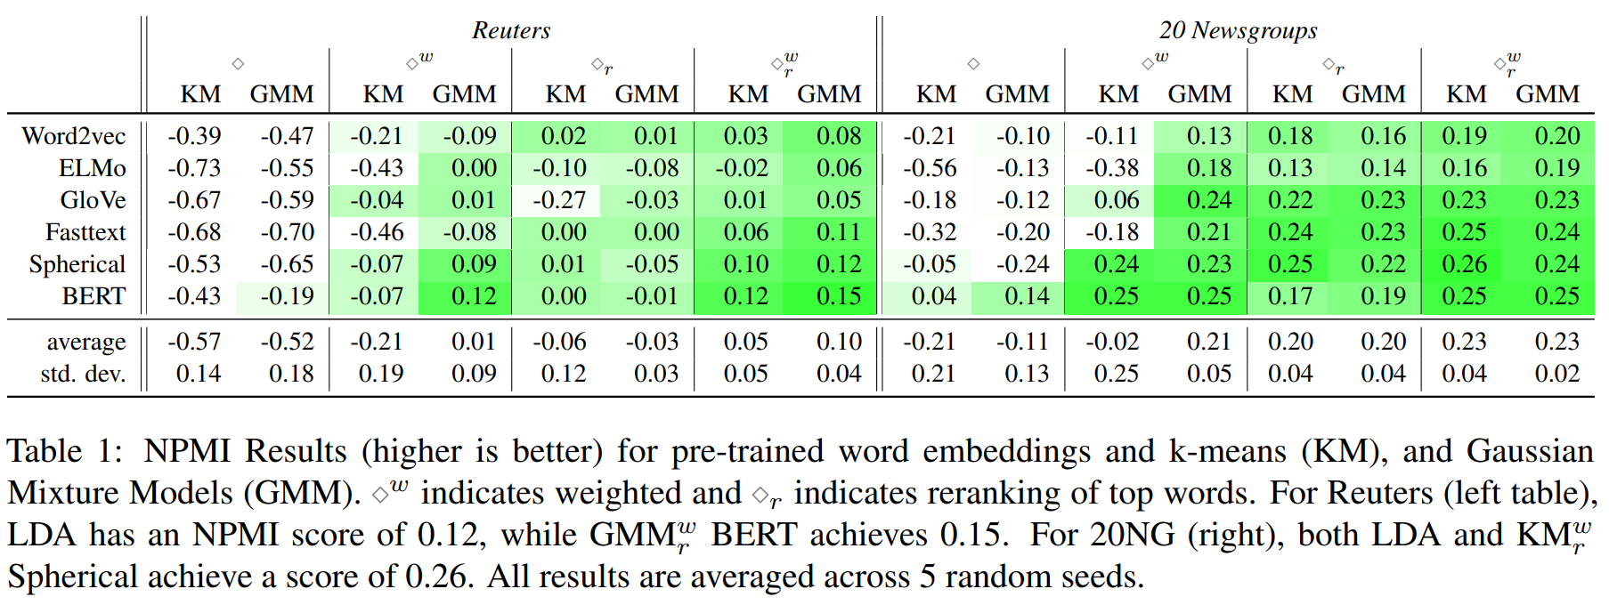
Experiments
20NewsGroup and Reuters Dataset
Split dataset into 60% training set and 40% test set. Training set is used to clustering and get top 10 words for each topic, while test set is used to evaluate the Normalized Pointwise Mutual Information as a measure of topic coherence.

Slide 30
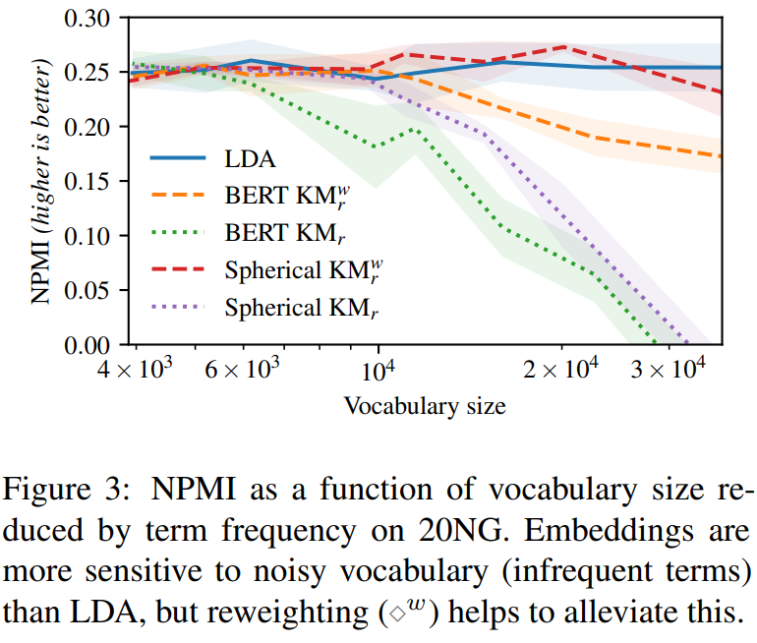
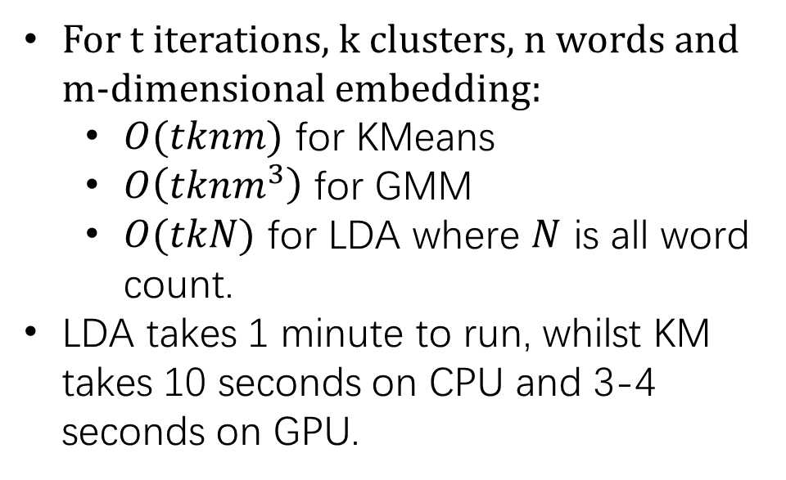
Influence of infrequent terms
Complexity
For t iterations, k clusters, n words and m-dimensional embedding:
$O(tknm)$ for KMeans
$O\left(tknm^{3}\right)$ for GMM
$O(tkN)$ for LDA where $N$ is all word count.
LDA takes 1 minute to run, whilst KM takes 10 seconds on CPU and 3-4 seconds on GPU.

Slide 31
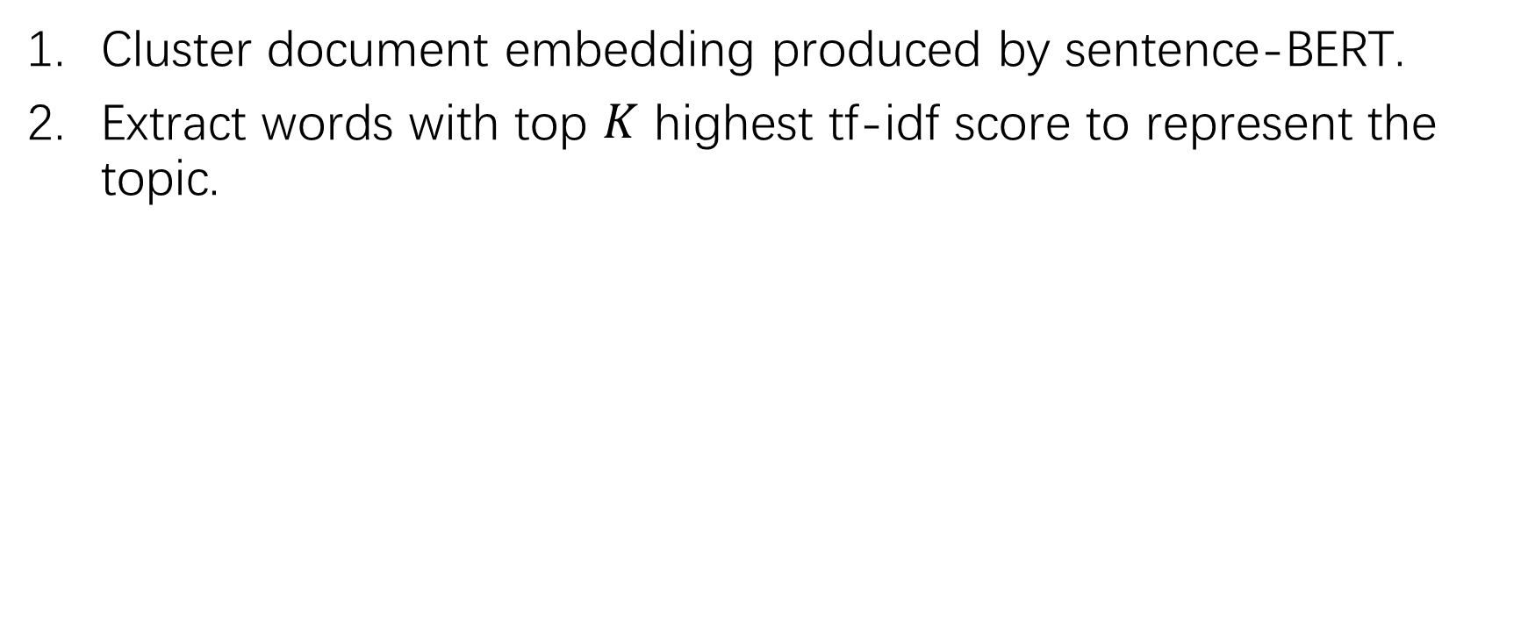
BERTopic
Cluster document embedding produced by sentence-BERT.
Extract words with top $K$ highest tf-idf score to represent the topic.

Slide 32
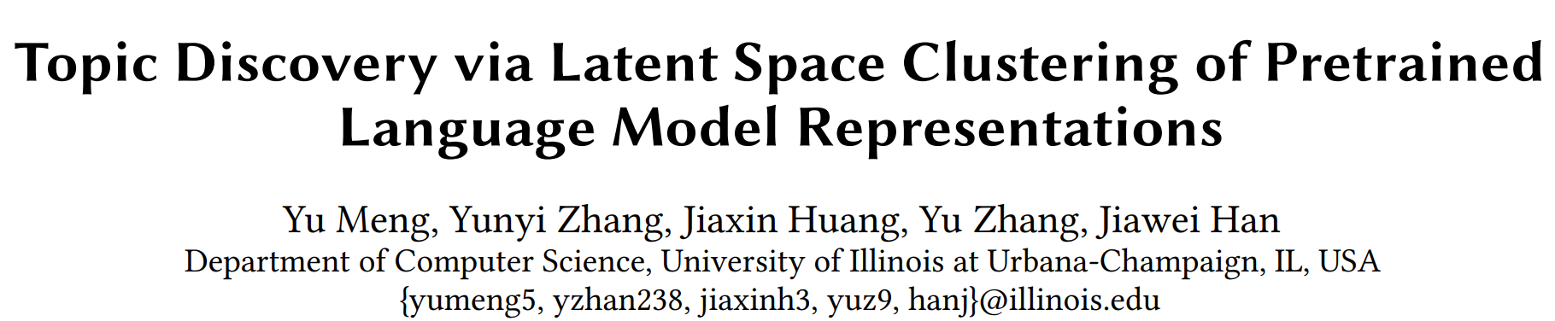
WWW 2022

Slide 33
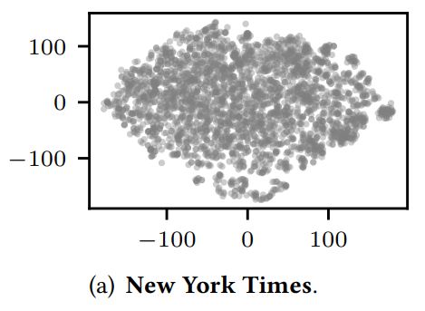
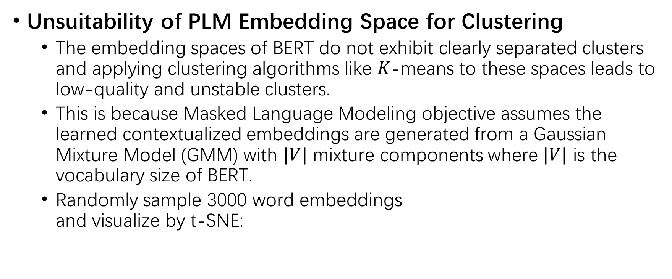
Challenges for PLM-based Topic Model
Unsuitability of PLM Embedding Space for Clustering
The embedding spaces of BERT do not exhibit clearly separated clusters and applying clustering algorithms like 𝐾-means to these spaces leads to low-quality and unstable clusters.
This is because Masked Language Modeling objective assumes the learned contextualized embeddings are generated from a Gaussian Mixture Model (GMM) with $|V|$ mixture components where $|V|$ is the vocabulary size of BERT.
Randomly sample 3000 word embeddings and visualize by t-SNE:

Slide 34
Challenges for PLM-based Topic Model
Curse of Dimensionality
The Euclidean distance is no longer reliable in a high-dimensional space, causing Euclidean distance based clustering algorithms ineffective.
Lack of Good Document Representations from PLMs
BERT document embedding obtained from [CLS] is bad as stated in Sentence-BERT.
Using Sentence-BERT for topic modeling raises two issues:
When the corpus significantly diverges with the training set of Sentence-BERT, retraining is needed. However, training Sentence-BERT requires manual labels in Natural Language Inference task, which contradicts with the unsupervised nature of topic modeling.
The sentence embedding lies in a different latent space against word embeddings, thereby cannot be used to model document-topic distribution.

Slide 35

Methodology

Slide 36




Methodology
Learning Document Embedding
Attentively pool word embeddings into the document embedding. Keep the word embedding $h_{i}^{\left(w\right)}$ fixed.
Spherical Topic Space
Project the original embedding space $H∈ℝ^{r}$ to spherical latent space $Z∈ℝ^{r^{′}},∀z∈Z, |\left|z\right||=1$. The variables in $Z$ follow $K$ mixture of $r^{′}$-variate von Mises-Fisher distribution ($t$ is mean):
$$p\left(z;t,κ\right)=n_{r^{′}}\left(κ\right)\exp\left(κ⋅\cos\left(z,t\right)\right)$$
Critical point is to design objectives to learn a good mapping from $H$ to $Z$, which is captured by $z=DNN\left(h\right)$.

Slide 37

Methodology
Generation Process
Sample topic $t_{k}∼Uniform(K)$
Sample latent word representation $z_{i}^{(w)}∼vMF(t_{k},κ)$
Map the latent word back to the original word embedding space $h_{i}^{(w)}=DNN(z_{i}^{(w)})$
This generation pipeline is the same for documents:

Slide 38




Training
Cluster in Spherical Space: Jointly learn the topic latent space and the assignment of topics.
$p(t_{k}|z_{i}^{(w)})$ is the topic assignment for each word;
$q(t_{k}|z_{i}^{(w)})$ is the target topic assignment for each word, just like the average of cluster nodes in KMeans.
Move $p$ towards $q$ by minimizing cross-entropy:
$q$ encourages distinctive topic assignment ($p^{2}$) and balanced clustering ($s_{k}$).

Slide 39




Training
Reconstruct Document
Ensure the learned latent topics are meaningful summaries of the documents.
Preserve PLM embeddings
Ensure the latent space preserves the important semantic information of the original embedding space

Slide 40

Training

Slide 41
Experiments
Datasets
NewYorkTime(NYT); Yelp.
Metrics
Topic Coherence
Umass, UCI
Intrusion: Given the top words in a topic, we randomly inject one word from another topic then employ a human evaluator to identify this outlier. The precision is used.
Topic Diversity
The percentage of unique words in one topic.
Document Clustering
Normalized Mutual Information between clusters

Slide 42


Experiments

Slide 43

Experiments
Missing experiments validating the effectiveness of each loss function;
Missing experiments of topic sparsity (as stated) and topic balance.

Slide 44

Summary
Lacks unified metrics/tasks to evaluate the model.
The dataset is small.
Neural methods is generally better than traditional methods when incorporating word embeddings.
Methodology
Project into a low dimensional latent space is necessary
How to jointly project contextualized word embeddings and document embeddings
How to design proper $p(z)$, $p(w|z)$ and $p(z|d)$ in the latent space

